Slide 1
Figures by species
1
Present – seasonal maps, 2 depths
Future 245 – seasonal maps, 2 depths
Future 585 – seasonal maps, 2 depths
Future 245 – decadal and hovmuller
Future 585 – decadal and hovmuller

Slide 2
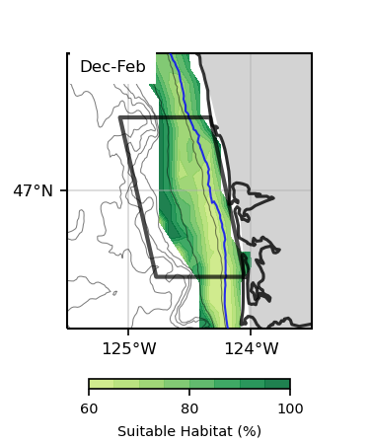
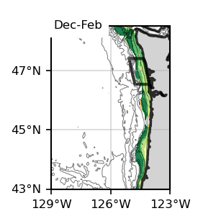
Surface
Bottom
1
1
Surface
Bottom
1
1

Slide 3
Dungeness Crab

Slide 4
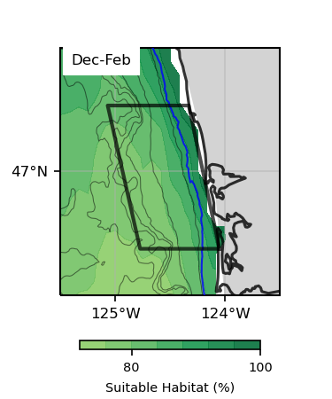
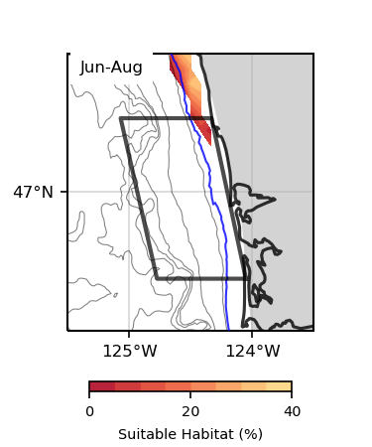
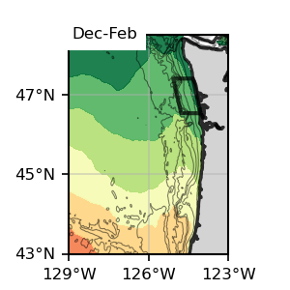
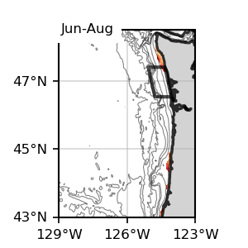
Surface
Surface
1
1
Dungeness Crab
Surface, present SSP245
1993-2019

Slide 5
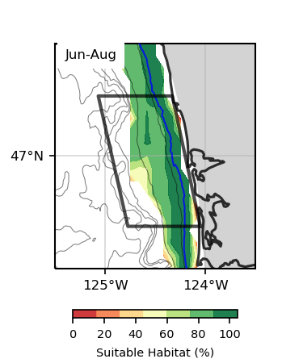
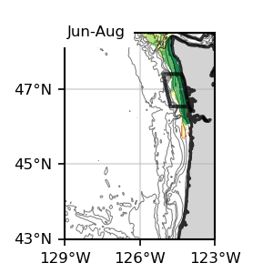
Bottom
Bottom
1
1
Dungeness Crab
Bottom, present SSP245
1993-2019

Slide 6
Surface
Bottom
1
1
Surface
Bottom
1
1

Slide 7
Bottom
1
Bottom
1

Slide 8
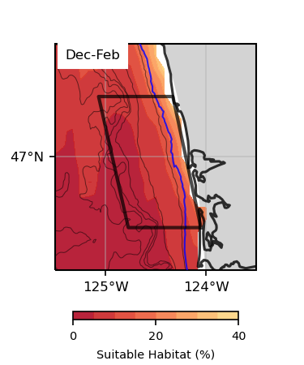
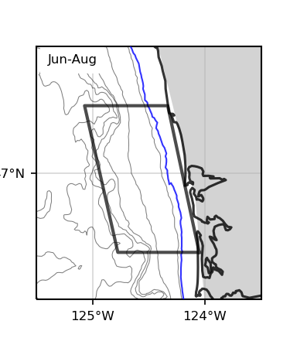
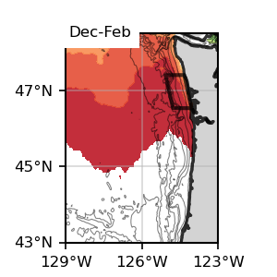
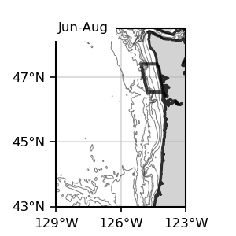
Surface
Surface
Dungeness Crab
Surface, Future, SSP 245
2060-2080

Slide 9
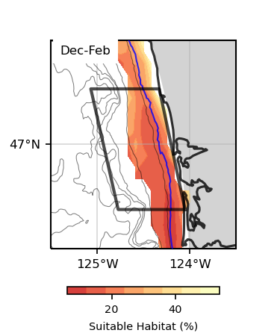
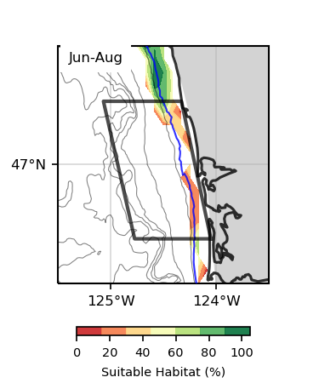
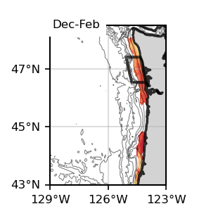
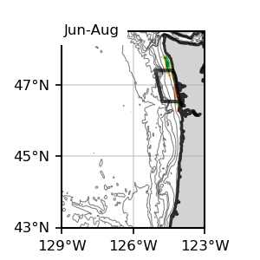
Bottom
Bottom
Dungeness Crab
Bottom, Future, SSP 245
2060-2080

Slide 10
Surface
Bottom
1
1
Surface
Bottom
1
1

Slide 11
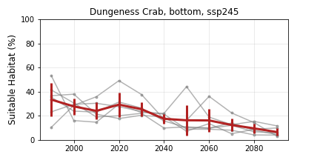
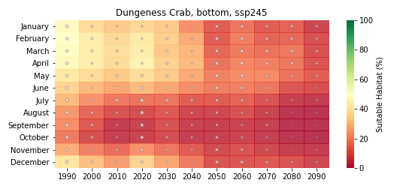
Bottom
1
Bottom
1

Slide 12
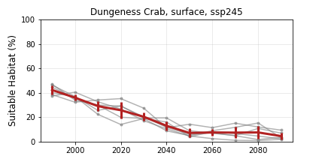
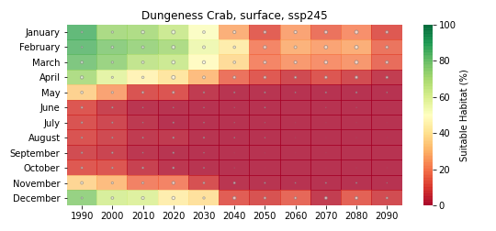
Dungeness Crab
Future, SSP 245

Slide 13
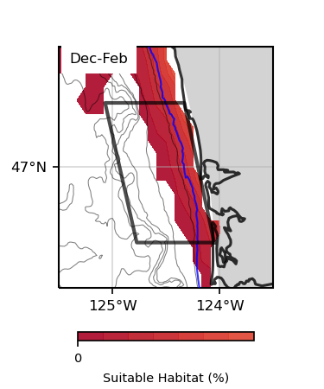
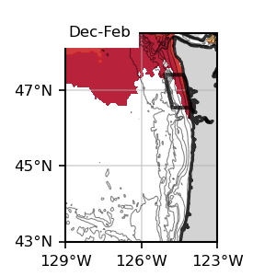
Surface
Surface
Dungeness Crab
Surface, Future, SSP 585
2060-2080

Slide 14
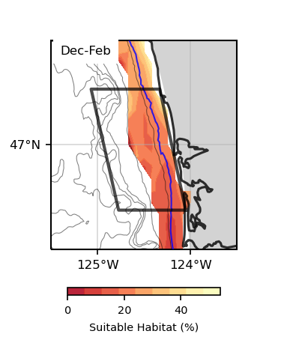
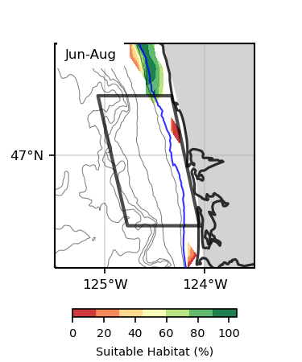
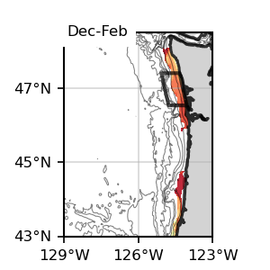
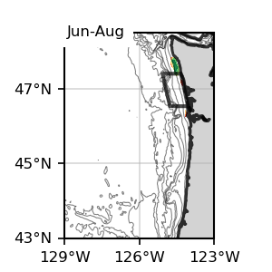
Bottom
Bottom
Dungeness Crab
Bottom, Future, SSP 585
2060-2080

Slide 15
Surface
Bottom
1
1
Surface
Bottom
1
1

Slide 16
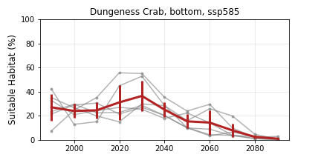
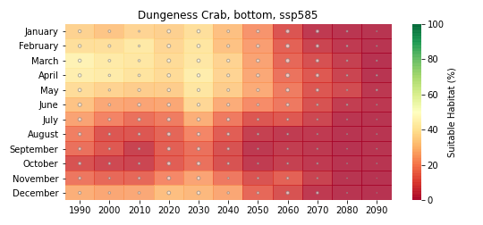
Bottom
1
Bottom
1

Slide 17
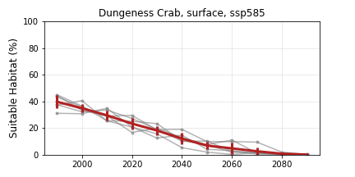
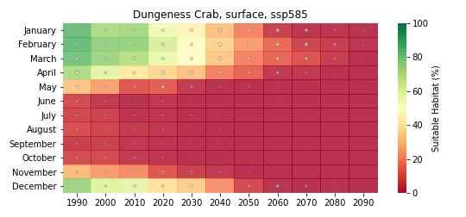
Dungeness Crab
Future, SSP 585

Slide 18
Sablefish

Slide 19
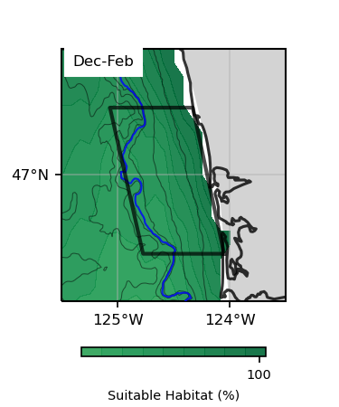
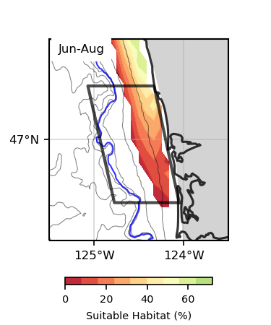
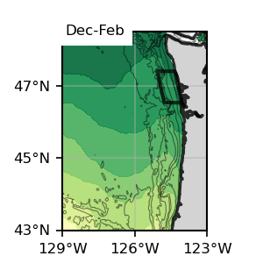
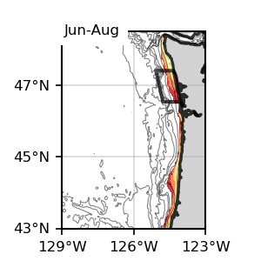
Surface
Surface
1
1
Sablefish
Surface, present SSP245
1993-2019

Slide 20
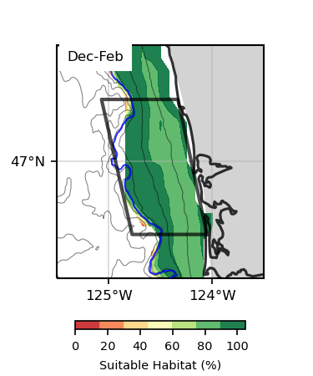
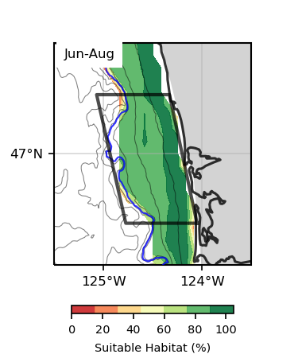
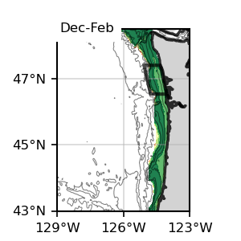
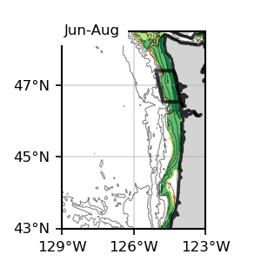
Bottom
Bottom
1
1
Sablefish
Bottom, present SSP245
1993-2019

Slide 21
Surface
Bottom
1
1
Surface
Bottom
1
1

Slide 22
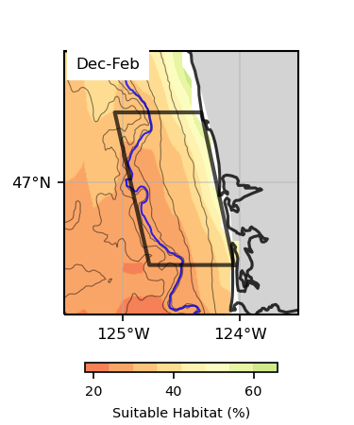
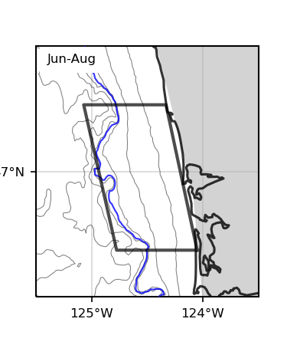
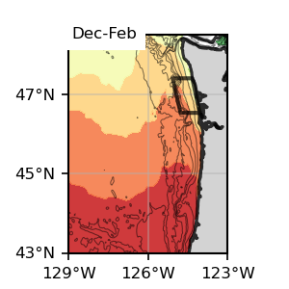
Surface
Surface
1
1
Sablefish
Surface, Future 245
2060-2080

Slide 23
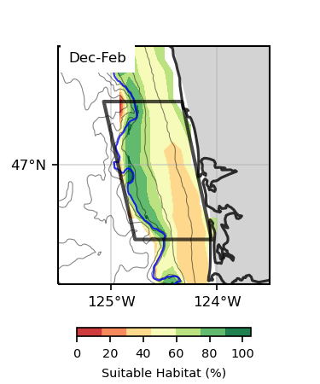
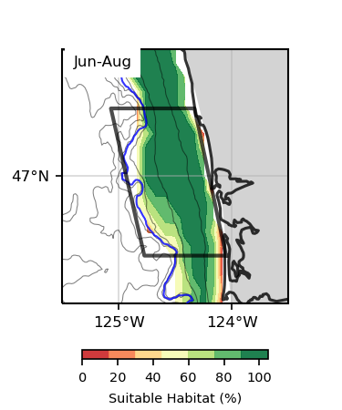
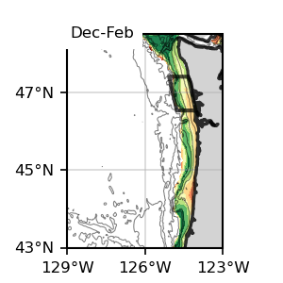
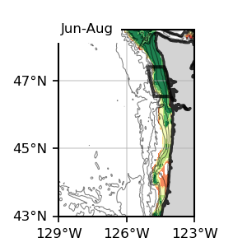
Bottom
Bottom
1
1
Sablefish
Bottom, Future 245
2060-2080

Slide 24
Surface
Bottom
1
1
Surface
Bottom
1
1

Slide 25
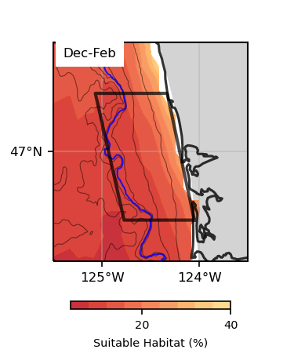
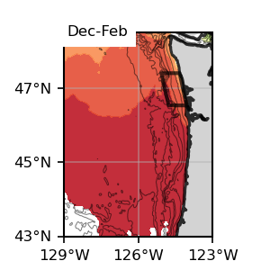
Surface
Surface
1
1
Sablefish
Surface, Future 585
2060-2080

Slide 26
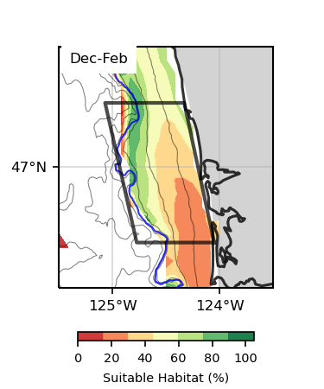
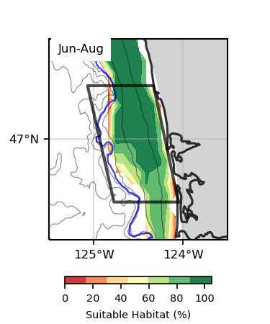
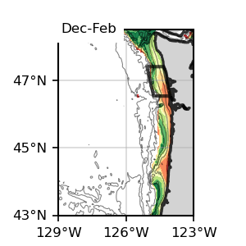

Bottom
Bottom
1
1
Sablefish
Bottom, Future 585
2060-2080

Slide 27
Surface
Bottom
1
1
Surface
Bottom
1
1

Slide 28




Sablefish
Future 245

Slide 29




Sablefish
Future 585

Slide 30
Halibut

Slide 31



Surface
Surface
1
1
Halibut
Surface, present SSP245
1993-2019

Slide 32




Bottom
Bottom
1
1
Halibut
Bottom, present SSP245
1993-2019

Slide 33
Surface
Bottom
1
1
Surface
Bottom
1
1

Slide 34
Bottom
1
Bottom
1

Slide 35



Surface
Surface
1
1
Halibut
Surface, Future 245
2060-2080

Slide 36




Bottom
Bottom
1
1
Halibut
Bottom, Future 245
2060-2080

Slide 37
Surface
Bottom
1
1
Surface
Bottom
1
1

Slide 38


Bottom
1
Bottom
1

Slide 39


Halibut
Future 245

Slide 40

Surface
Surface
1
1
Halibut
Surface, Future 585
2060-2080

Slide 41



Bottom
Bottom
1
1
Halibut
Bottom, Future 585
2060-2080

Slide 42
Surface
Bottom
1
1
Surface
Bottom
1
1

Slide 43


Bottom
1
Bottom
1

Slide 44


Halibut
Future 585

Slide 45
Chinook

Slide 46




Surface
Surface
1
1
Chinook
Surface, present SSP245
1993-2019

Slide 47




Bottom
Bottom
1
1
Chinook
Bottom, present SSP245
1993-2019

Slide 48
Surface
Bottom
1
1
Surface
Bottom
1
1

Slide 49



Surface
Surface
1
1
Chinook
Surface, Future 245
2060-2080

Slide 50




Bottom
Bottom
1
1
Chinook
Bottom, Future 245
2060-2080

Slide 51
Surface
Bottom
1
1
Surface
Bottom
1
1

Slide 52


Surface
Surface
1
1
Chinook
Surface, Future 585
2060-2080

Slide 53




Bottom
Bottom
1
1
Chinook
Bottom, Future 585
2060-2080

Slide 54
Surface
Bottom
1
1
Surface
Bottom
1
1

Slide 55




Chinook
Future 245

Slide 56




Chinook
Future 585

Slide 57
Coho

Slide 58




Surface
Surface
1
1
Coho
Surface, present SSP245
1993-2019

Slide 59




Bottom
Bottom
1
1
Coho
Bottom, present SSP245
1993-2019

Slide 60
Surface
Bottom
1
1
Surface
Bottom
1
1

Slide 61



Surface
Surface
1
1
Coho
Surface, Future 245
2060-2080

Slide 62




Bottom
Bottom
1
1
Coho
Bottom, Future 245
2060-2080

Slide 63
Surface
Bottom
1
1
Surface
Bottom
1
1

Slide 64


Surface
Surface
1
1
Coho
Surface, Future 585
2060-2080

Slide 65




Bottom
Bottom
1
1
Coho
Bottom, Future 585
2060-2080

Slide 66
Surface
Bottom
1
1
Surface
Bottom
1
1

Slide 67




Coho
Future 245

Slide 68




Coho
Future 585

Slide 69
Razor Clams

Slide 70




Surface
Surface
1
1
Razor Clams
Surface, present SSP245
1993-2019

Slide 71




Bottom
Bottom
1
1
Razor Clams
Bottom, present SSP245
1993-2019

Slide 72
Surface
Bottom
1
1
Surface
Bottom
1
1

Slide 73
Surface
1
Surface
1

Slide 74



Surface
Surface
1
1
Razor Clams
Surface, Future 245
2060-2080

Slide 75




Bottom
Bottom
1
1
Razor Clams
Bottom, Future 245
2060-2080

Slide 76
Surface
Bottom
1
1
Surface
Bottom
1
1

Slide 77


Surface
1
Surface
1

Slide 78


Razor Clams
Future 245

Slide 79


Surface
Surface
1
1
Razor Clams
Surface, Future 585
2060-2080

Slide 80




Bottom
Bottom
1
1
Razor Clams
Bottom, Future 585
2060-2080

Slide 81
Surface
Bottom
1
1
Surface
Bottom
1
1

Slide 82


Surface
1
Surface
1

Slide 83


Razor Clams
Future 585

Slide 84
Albacore

Slide 85




Surface
Surface
1
1
Albacore
Surface, present SSP245
1993-2019

Slide 86

Bottom
Bottom
1
1
Albacore
Bottom, present SSP245
1993-2019

Slide 87
Surface
Bottom
1
1
Surface
Bottom
1
1

Slide 88




Surface
Surface
1
1
Albacore
Surface, Future 245
2060-2080

Slide 89


Bottom
Bottom
1
1
Albacore
Bottom, Future 245
2060-2080

Slide 90
Surface
Bottom
1
1
Surface
Bottom
1
1

Slide 91




Surface
Surface
1
1
Albacore
Surface, Future 585
2060-2080

Slide 92


Bottom
Bottom
1
1
Albacore
Bottom, Future 585
2060-2080

Slide 93
Surface
Bottom
1
1
Surface
Bottom
1
1

Slide 94




Albacore
Future 245

Slide 95




Albacore
Future 585

